Slide 1

SIGN LANGUAGE RECOGNITION Project Phase-2(ECS899)
Project Guide:
Mr. Aaditya Jain
Assistant Professor
Submitted by:
Mohit Chauhan(TCA1809064)
Mohd. Zeeshaan(TCA19011002)
Piyush Verma(TCA1911008)

Slide 2

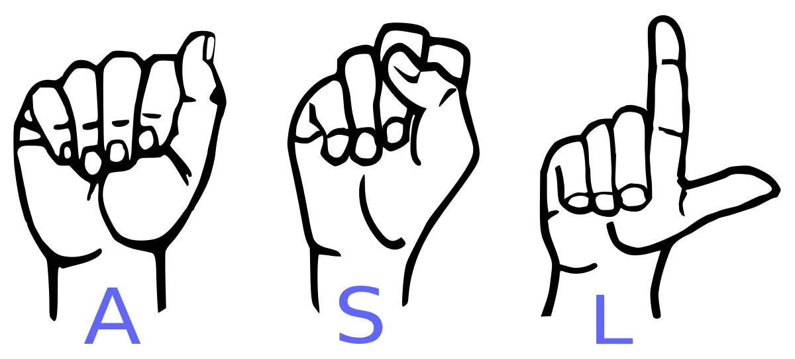
Conversion of Sign Language to Text
For Dumb and Deaf

Slide 3
CONTENT
Abstract
Software Requirements
Implementation
Challenges Faced
Limitations of our model
Conclusion
Future Scope
Reference

Slide 4

Abstract
Our project aims to create a computer application and train a model which when shown a real time hand gestures of American Sign Language shows the output for that particular sign in text format on the screen.

Slide 5
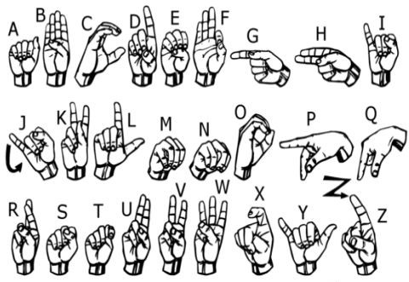
We implemented 27 symbols(A-Z, blank) of ASL in our project.

Slide 6

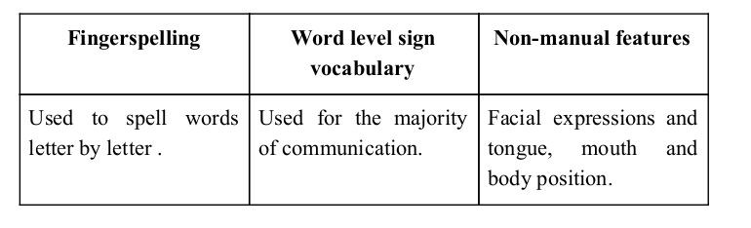
Sign language is a visual language and consists of 3 major components:

Slide 7
Software Requirements
Python 3.9
Tensorflow
OpenCV
NumPy
Matplotlib
Keras
PIL

Slide 8
Implementation
Whenever the count of a letter detected exceeds a specific value and no other letter is close to it by a threshold we print the letter and add it to the current string(In our code we kept the value as 50 and difference threshold as 20).
Otherwise we clear the current dictionary which has the count of detections of present symbol to avoid the probability of a wrong letter getting predicted.
Whenever the count of a blank(plain background) detected exceeds a specific value and if the current buffer is empty no spaces are detected.
In other case it predicts the end of word by printing a space and the current gets appended to the sentence below.

Slide 9
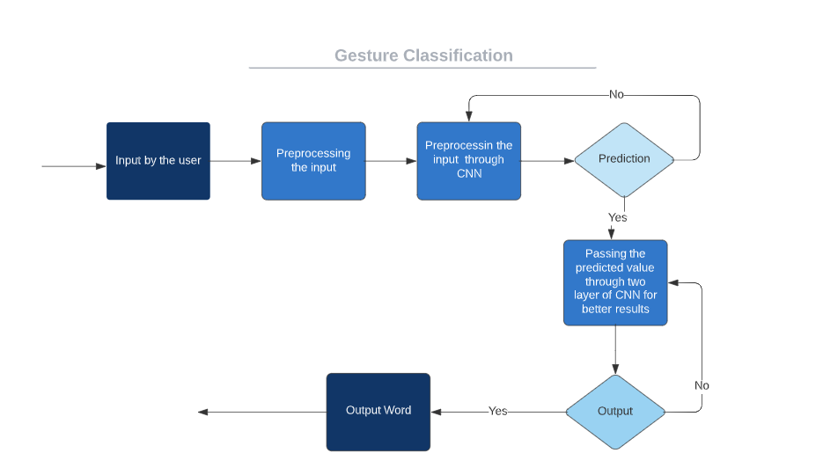
Gesture Classification

Slide 10
Convolutional Neural Networks
CNNs consist of multiple convolutional layers each layer containing numerous “filters” which perform feature extraction.
Initially these “filters” are random and by training, the feature extraction gets better by better.
It’s primarily used for image classification.

Slide 11
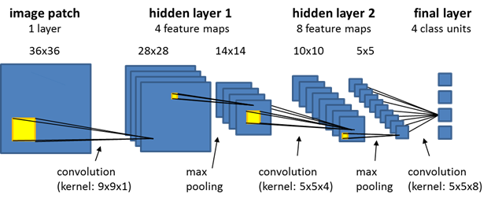
Convolutional Neural Network Layers

Slide 12
Challenges Faced
First issue was to select a filter for feature extraction. We tried various filter including binary threshold, canny edge detection, gaussian blur etc. ,of which gaussian blur filter was giving better results.
Issues were faced relating to the accuracy of the model we trained in earlier phases which we eventually improved by increasing the input image size and also by improving the dataset.

Slide 13
Limitations of our model
The model works well only in good lighting conditions.
Plain background is needed for the model to detect with accuracy.

Slide 14
Conclusion
In this report, a functional real time vision based american sign language recognition for D&M people have been developed for asl alphabets.
We achieved an accuracy of 89% on our dataset.
Prediction has been improved after implementing two layers of algorithms in which we verify and predict symbols which are more similar to each other.

Slide 15
Future Scope
We are planning to achieve higher accuracy even in case of complex backgrounds by trying out various background subtraction algorithms.
We are also thinking of improving the preprocessing to predict gestures in low light conditions with a higher accuracy.

Slide 16
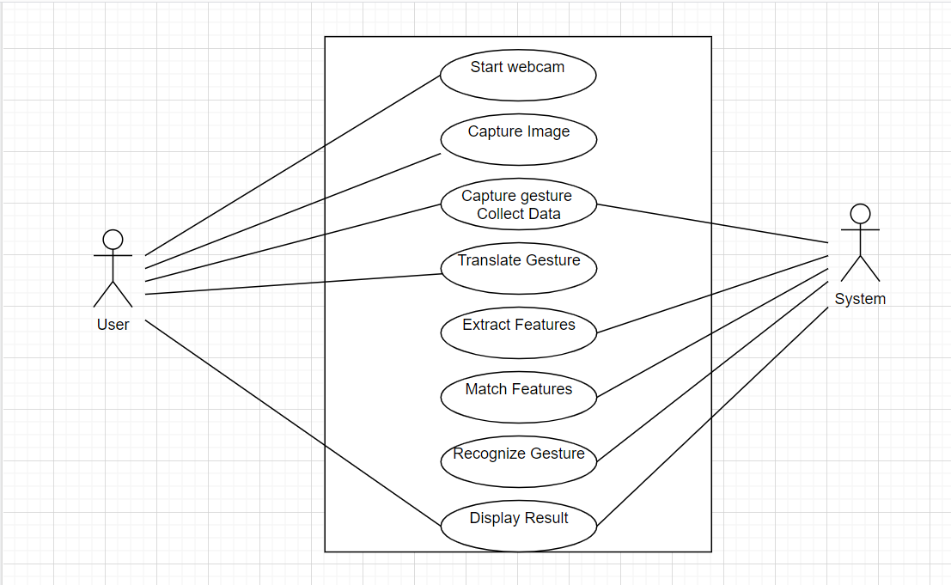
Use Case Diagram
.

Slide 17
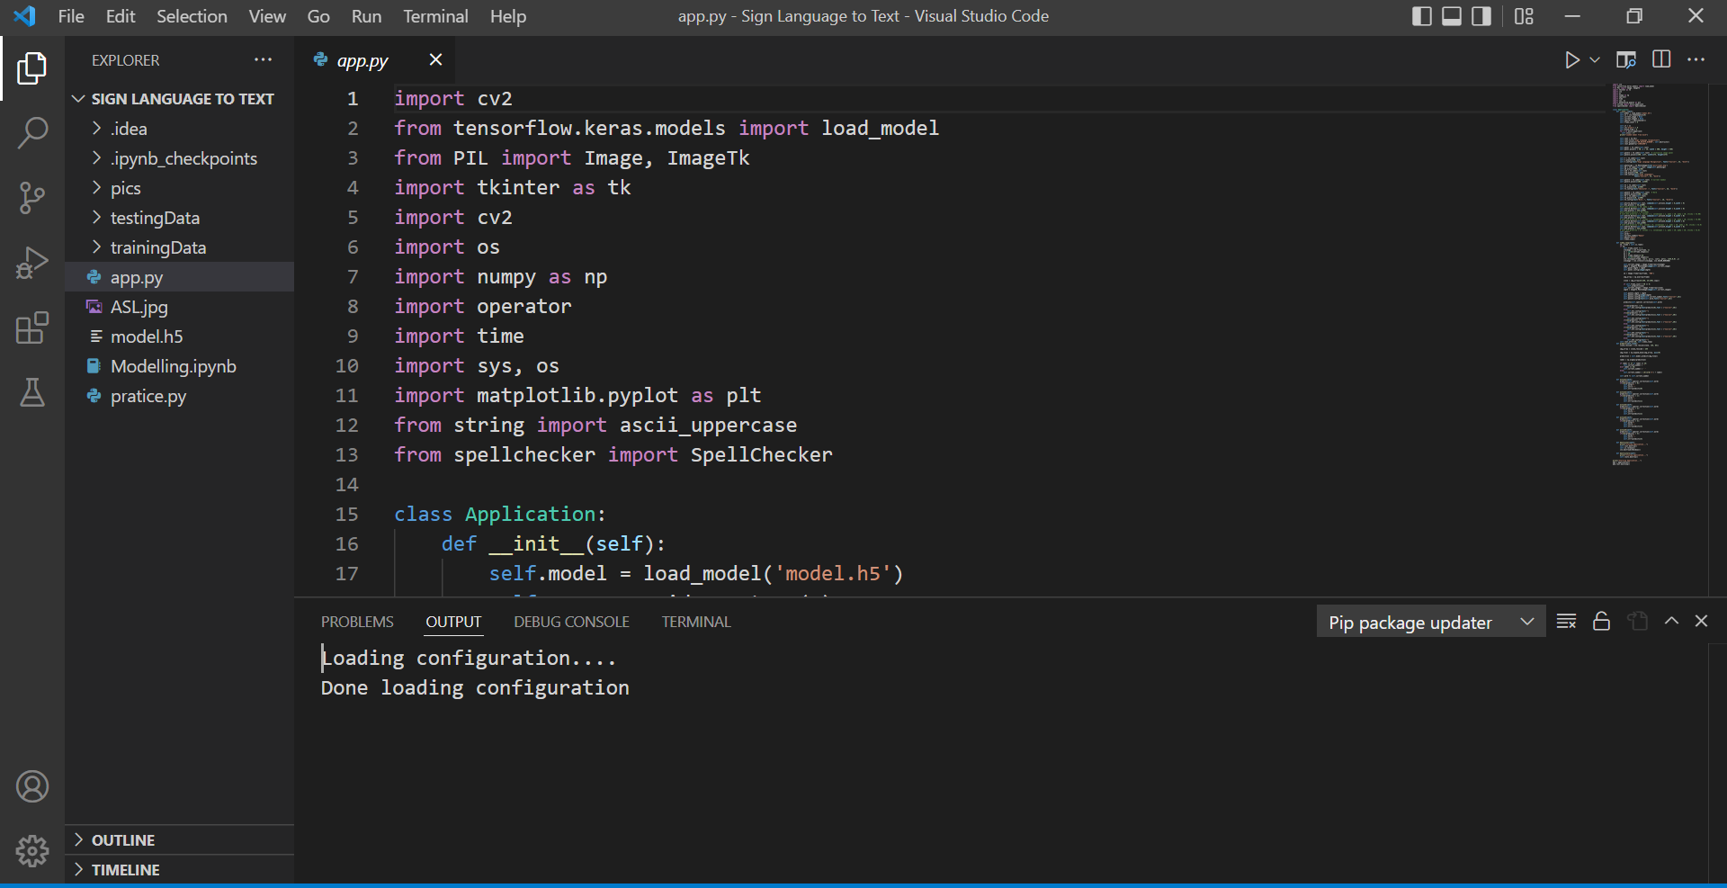
Screenshot

Slide 18
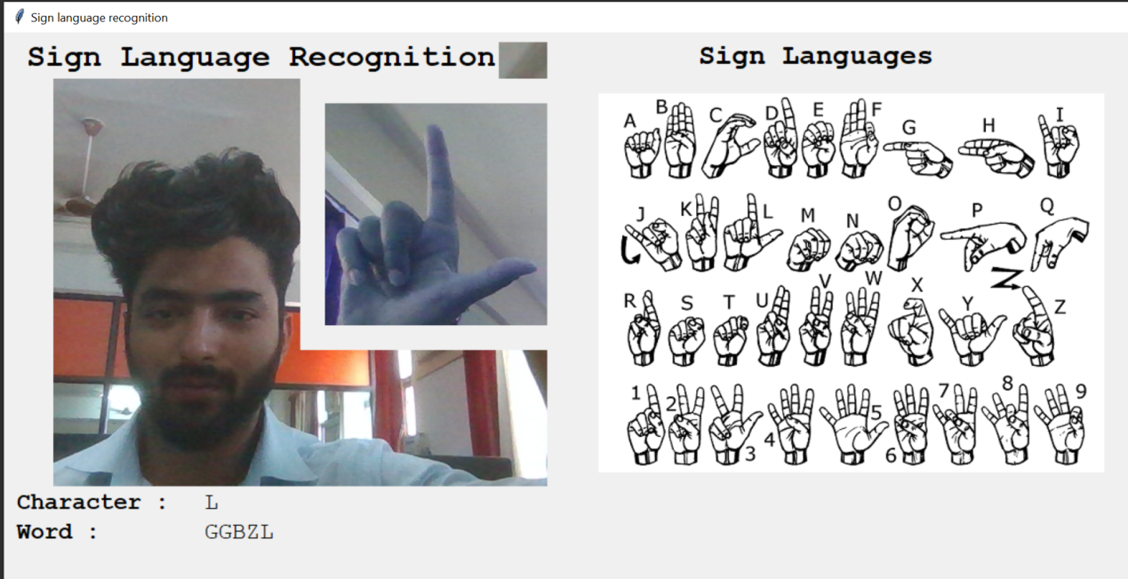
Screenshot

Slide 19
Reference
Python Course
www.github.com
www.youtube.com
www.simplifiedcoding.com
https://opencv.org

Slide 20
Thank you…!

